Slide 1
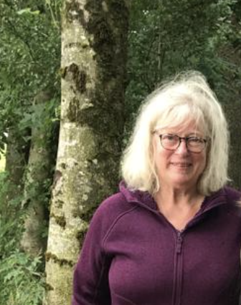
Catching your breath
Venetia Young
Shelley Murphy
Temple Sowerby Medical Practice

Slide 2
Welcome to breathing workshop
Understand the subtle effect of breathing on all bodily functions
Understand Oxygen, Carbon dioxide, Nitric Oxide, Magnesium in the body
Autonomic nervous system - adrenaline, the vagus nerve and flight fight and freeze
Nasal breathing
Learn how to breathe differently for symptom control
Effective breathing for yourself, so that you feel better and more confident

Slide 3
Venetia Young
Childhood asthma
7/11 breathing 20 years as GP. Stress flowchart
James Nestor - Breath
Research on slow breathing and cognitive function
COVID Feb and Sept 2023
Buteyko coaching: Control pause score. Many small breath holds, breathe less, coherent breathing, humming on out breath. (McKeown)
Mouth v nasal breathing: snoring, sleep apnoea, Mouth taping- Myotape
Buteyko training 2024 with Patrick McKeown in Ireland
Asthma and Chronic hyperventilation. Post natal depression x2

Slide 4
Shelley Murphy
Practised yoga 20+ years
Body, mind and movement all important
Covid pandemic - yoga and breathwork twice daily
Qualified as Breathwork coach 2023
Power of the breath to help so many people
Started using yoga for back pain, and then breathwork for anxiety and panic attacks

Slide 5
How was your breathing on the way here?
How is it now?
3 breaths

Slide 6
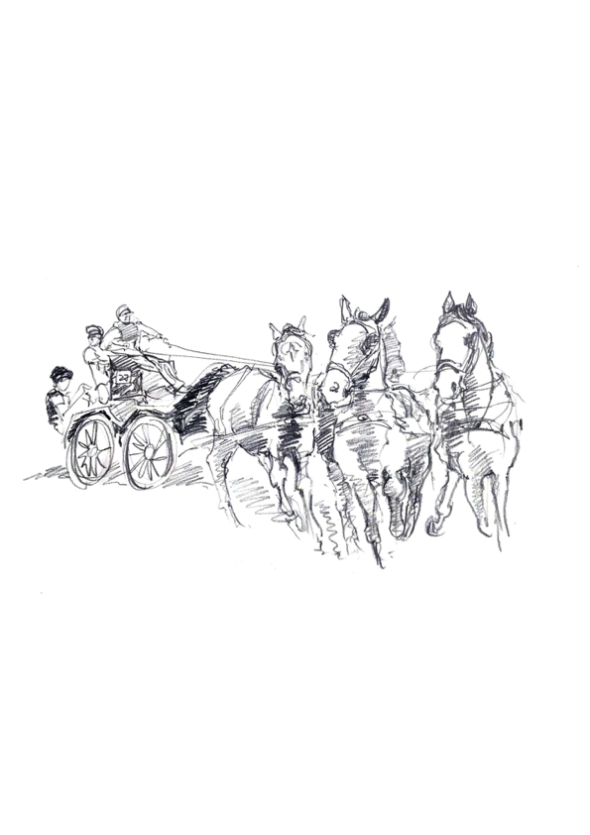
Controlling the body on its journey

Slide 7
Charles 72
Panic attack or a heart attack?

Slide 8
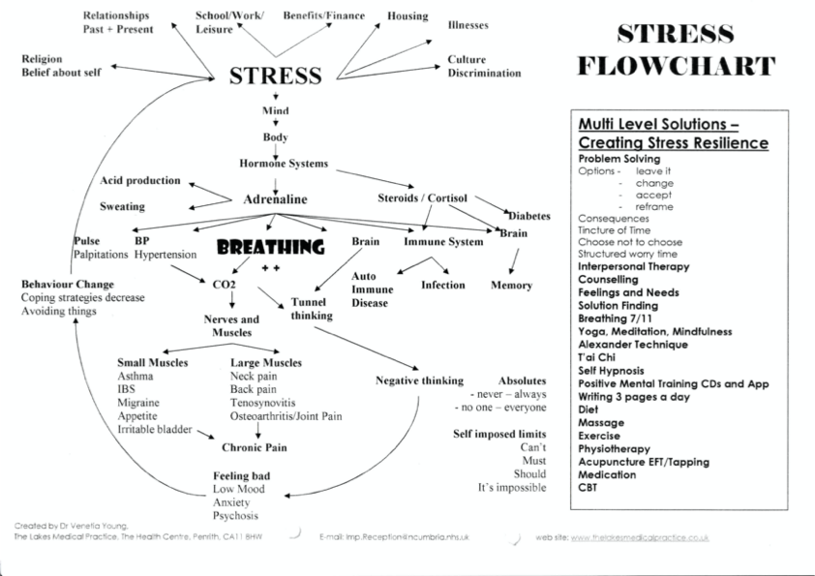
Managing adrenaline and cortisol

Slide 9
CHILDREN, Young people and breathing
2 year old and nappy changing
Asthma in 16 year old - context
Is it asthma? 50% hyperventilate
Mouth-breathing 50% (more boys than girls)
Learning ability, behaviour and psychological well-being
Daytime tiredness
Changes in face and teeth
https://buteykoclinic.com/crookedteeth/

Slide 10
ADULTS
Back Pain
Diabetes
Panic attacks, anxiety and depression, bipolar
Menopause
COPD
Asthma
Chronic pain
High BP
Chronic hyperventilation

Slide 11
NOSE and Mouth breathing
Cyclists improve timing simply by changing to nasal breathing
Animals only mouth breathe when sick

Slide 12
Is this making sense?
Around your tables what struck you most about the stress cycle?
What isn’t clear yet?

Slide 13
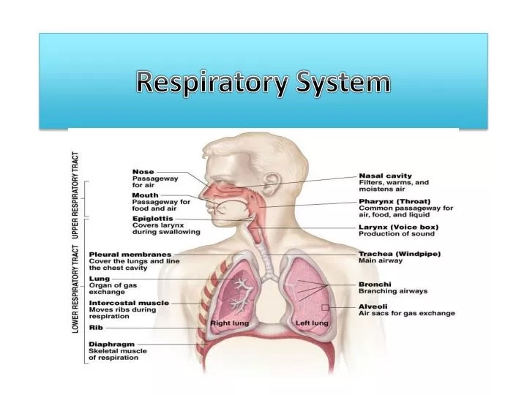
Biomechanics of breathing

Slide 14
CHEMISTRY of breathing
Oxygen
Carbon dioxide
Bohr effect
Nitric oxide, nasal breathing, humming
Calcium
Magnesium
Biomechanics: nasal airway, throat, lungs, diaphragm, intercostal muscles
Control pause

Slide 15
Autonomic nervous system - 7/11 breathing
Sympathetic - adrenaline - active
Parasympathetic -calming
Vagus nerve innervation
7/11 breathing
Heart rate variability
Let’s have a practice 7/11

Slide 16
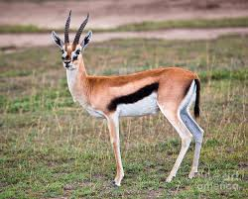
Flight fight and freeze

Slide 17
The brain and breathing
Amygdala
Hippompus
Limbic system
Carbon dioxide monitoring centre

Slide 18
breathing patterns
7/11 breathing
Small breath holds - panic attacks
Breathing around a square - army and navy - 4444 - relaxed alertness
Sat nam
Humming on out breath - Bee breath
Coherent breathing - Tibetan bells

Slide 19
Breathing and you
Before day begins
Before opening emails
Before going home
Before exercise
Before sleep
Singing
Thich Nat Hanh and Plum village, France
What will be your breathing plan?

Slide 20
Questions anD nexT steps
Questionnaire
Practice and notice
Meet in a month
And then?

Slide 21
Learning for inquisitive minds
James Nestor: Breath
Patrick McKeown: The Breathing Cure and the Oxygen Advantage
https://buteykoclinic.com/the-buteyko-method/
https://buteykoclinic.com/crookedteeth/
Dr Louise Oliver - GP and breath coach
https://www.drlouiseolivertherapeuticlifecoaching.com/podcast-information
Neil Tranter: the Buteyko method https://www.youtube.com/watch?v=ZZvgKzySOgU

