Slide 1
Managing distress and the menopause
Dr Venetia Young
Retired GP and Family Therapist

Slide 2
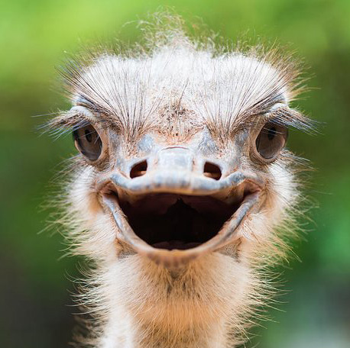
Ostrich

Slide 3
Why are we here?
Over a cuppa……..a plan was hatched
Writing articles in BJGP - James Rebanks books
Patients as flocks, GP as shepherd, practice staff as sheep dogs
Back out into community, educating and empowering across several long term conditions: asthma, heart disease, mens health……
Start with menopause - because menopausal women are the lynchpin of their families and communities and have loads of symptoms.
Previous experience x3

Slide 4
And then…
Radical Birds: Group of like minded women with a passion for community and especially for getting women’s and girls’ voices heard from the cradle to the grave. As people not patients.
Other working GPs interested especially in terms of rewilding General Practice and thinking differently.
CHOC keen to support it
Dr Cath Munro Kendal - Menopause cafes in South Cumbria
She wants every GP in Cumbria to know the basics of the menopause, some to develop a special interest and others like her to get the full British Menopause Society training. A menopause clinic supported properly by community groups. Local research for our rural communities.
CHOC training in September. RCGP Cumbria faculty
Radical Birds want women’s empowerment across Eden: Appleby, Kirkby Stephen, Shap, Alston, Penrith. Awareness, information and learning together. Menopause champions in lots of surprising places

Slide 5
Beginning in Temple Sowerby.
Awareness
Information - resources
Listening and learning together
Asking for what you need next
Post it notes galore

Slide 6
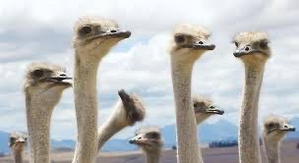

Slide 7
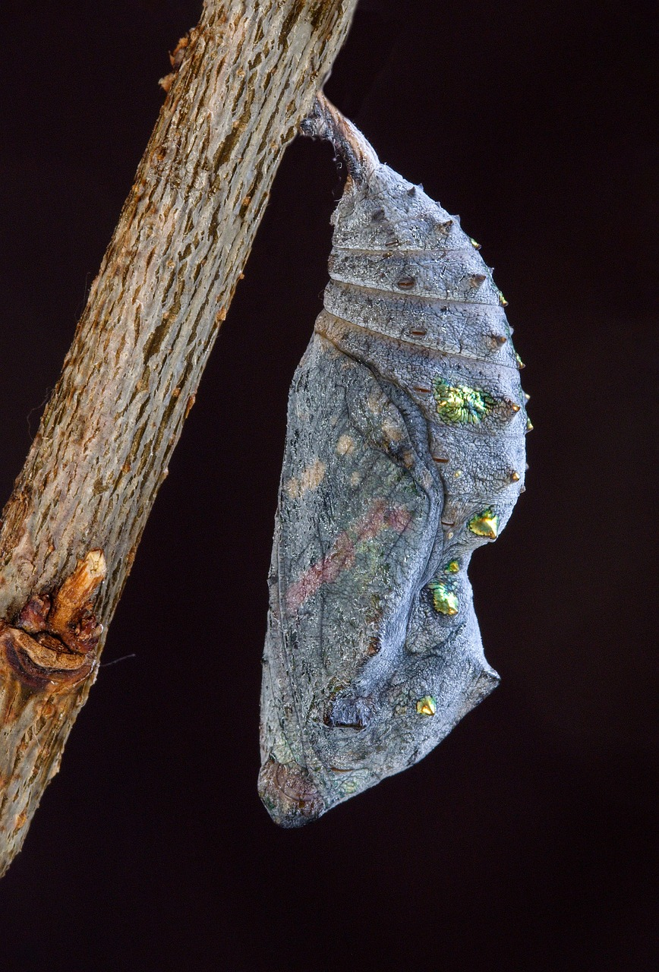
Menopause and imaginal cells

Slide 8
The journey of the female body
First period
Coils and pills
3 babies under 4 for a week. Breastfeeding didn’t work as a contraceptive
Miscarriage- mid trimester
Floods
Last period and post-menopausal bleed
Work and migraine
Now

Slide 9
Betty 58
Consulted frequently with headache, back pain, hip pain, indigestion, palpitations, mild asthma and raised BP
Frequent attenders audit
Family tree
Problem solving, Eden Carers (aromatherapy), explained how stress gets in the body, relaxation technique,
‘Women Who Love Too Much’ by Robin Norwood

Slide 10
Charles 72
Crescendo angina with stent successfully put in coronary arteries
Presented in surgery as emergency
Hyperventilation, Panic attack

Slide 11
Management
Grounding
Slow breathing 7/11
Explanation of how his body worked drawing stress flowchart
“This has to be made into a chart for everyone to see. It’s so important to understand how your body works. Then you can take charge of your emotions.”

Slide 12
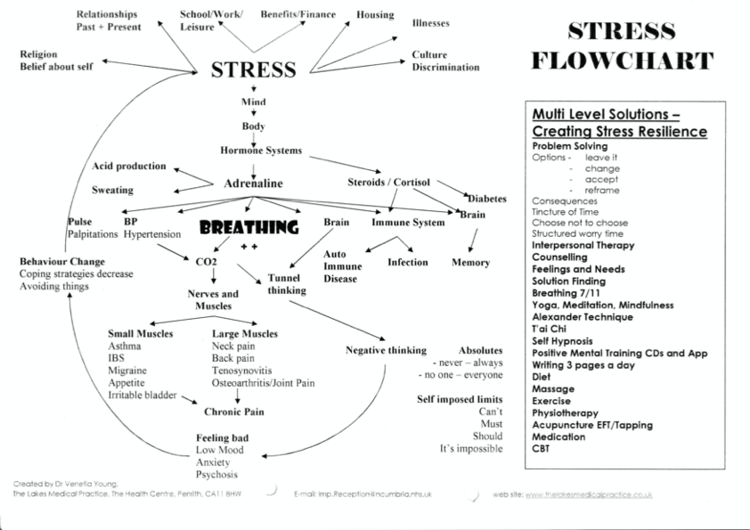

Slide 13
Stress
Basic physiology of the breath
Oxygen
Carbon Dioxide
Nitric oxide
Magnesium

Slide 14
Breathing and Women’s Health
Menstrual cycle - progesterone
Painful periods
Premenstrual syndrome - over breathing
Pregnancy - breathe faster
Menopause - frontal lobe oestrogen receptors
Distress, anxiety, depression: antidepressants and CO2
Osteoporosis and anxiety

Slide 15
Magnesium
Indigestion (pregnancy)
Constipation
Severe asthma
Angina and arrythmias
Epilepsy
Migraine
Mental health problems
Alcohol problems
Sleep
Hypertension

Slide 16
Magnesium rich foods
Dark chocolate
Avocado
Nuts (almonds cashews brazils)
Legumes/beans lentils and chickpeas
Wholegrain
Fatty fish - salmon mackerel halibut
Bananas
Leafy greens - kale and spinach

Slide 17
Stress - autonomic nervous system
Fight, fright, freeze response - sympathetic nervous system
Vagus nerve: heart, breathing, thinking, voice, facial recognition - parasympathetic nervous system
Heart rate variability.
Frontal lobes - thinking change

Slide 18
Stress- neuroscience
Amygdala
Limbic system
Carbon dioxide monitoring centre
Adverse childhood experiences (ACEs)

Slide 19
Better breathing
Nasal breathing
Slow
Long breath out
Using diaphragm and base of lungs - horizontal
5.5 breaths per minute optimum
Mouth breathing at night - use micropore tape
Coherent breathing

Slide 20
What else does slow breathing help with?
Worried thinking and problem solving
Sleep
Pain
IBS, migraine and tension headaches, angina, blood pressure, asthma, osteoarthritis, epilepsy, irritable bladder, auto-immune conditions

Slide 21
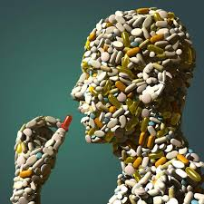
A pill for every ill?

Slide 22
Specific techniques for distress
7/11 (How to Liberate yourself from Pain - Graham Browne)
Box breathing. 4444 around a picture
Paired breaths, stepped breaths
Cupped hands (not a paper bag)
Coherent breathing

Slide 23
7/11 breathing practice
In to the count of 7 (think - stretch)
Slight pause
Out to the count of 11(think -relax and let go)
Using belly
Shoulders down

Slide 24
What do you as women need and want for your physical and mental health?
GP
Nurse - contraception and cervical cancer screening
Midwife and health visitor
Gynaecologist and obstetrician
Mammography
Breast surgeon
Cancer specialist for women’s issues
Urologist
Incontinence nurse - bladder and bowel
Pelvic floor physio
Psychosexual counsellor
Psychiatrist, psychologist, psychiatric nurse, counsellor

Slide 25
Archipelago medicine

Slide 26
Closer to home
Personal coach
Personal trainer
Pilates/yoga/tai chi
Nutritionist/dietician
Well-being advisor/sign-poster
Breath coach
Well-informed friends/family/community

Slide 27
Resources
James Nestor - Breath
Patrick Mckeown - Oxygen Advantage and the Breathing Cure
Louise Newsom Health
Menopause support uk
Bloody Amazing Facebook
Radical Birds Facebook

Slide 28
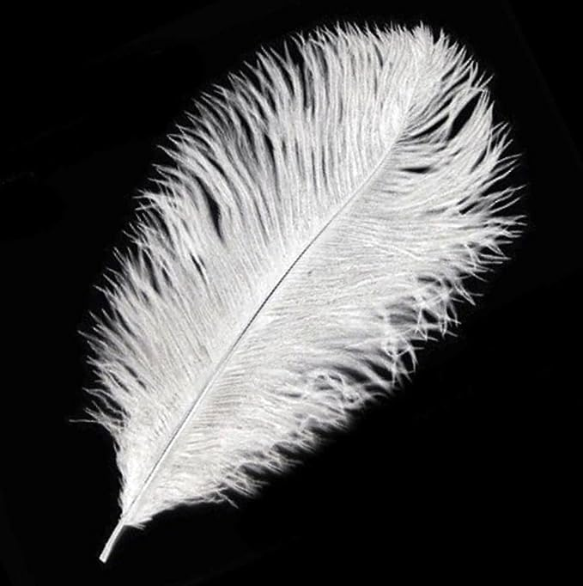
Birds of a feather

Slide 29
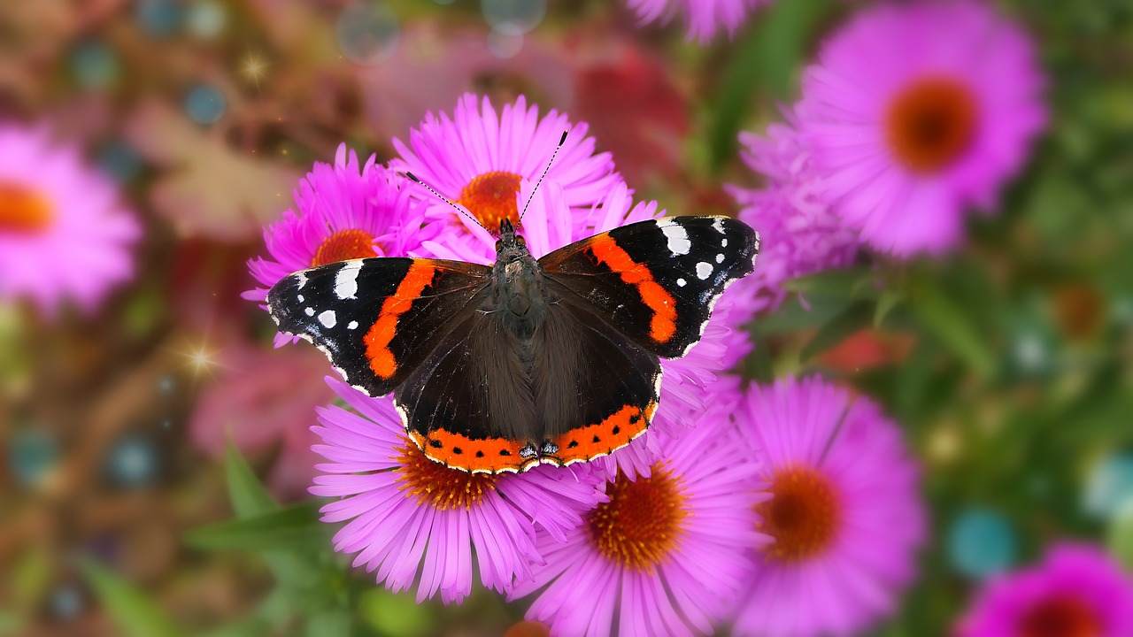
Thank you!

Slide 30
There is no more creative force in the world than the menopausal woman with zest.
— Margaret Mead

